Slide 1
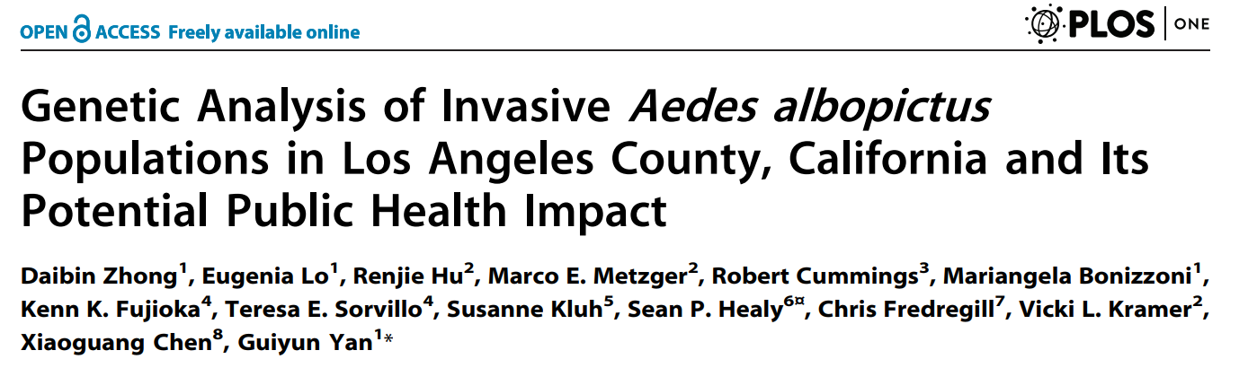
David Hall and Ludvin Mejia
Approachable and poorly documented

Slide 2
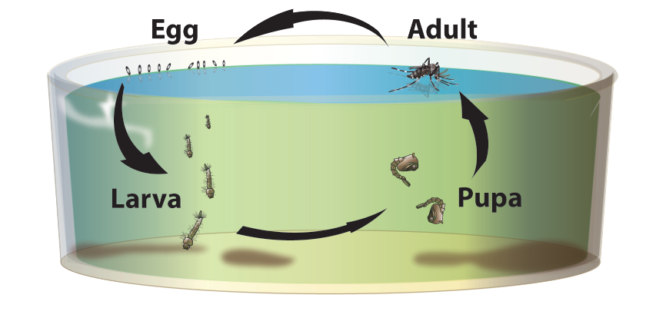


Aedes life cycle
Lays eggs in containers of water
Eggs are resistant to desiccation
Containers shipped around world
Tire trade
Exotic plants
Used tires
Lucky bamboo
Notes:
Images:
https://www.sandiegocounty.gov/content/sdc/deh/pests/Mosquitoes/about_mosquitoes.html
https://keyw.com/prevent-mosquito-breeding-get-rid-of-old-tires-free/
https://www.ocvector.org/prevent-an-aedes-infestation

Slide 3

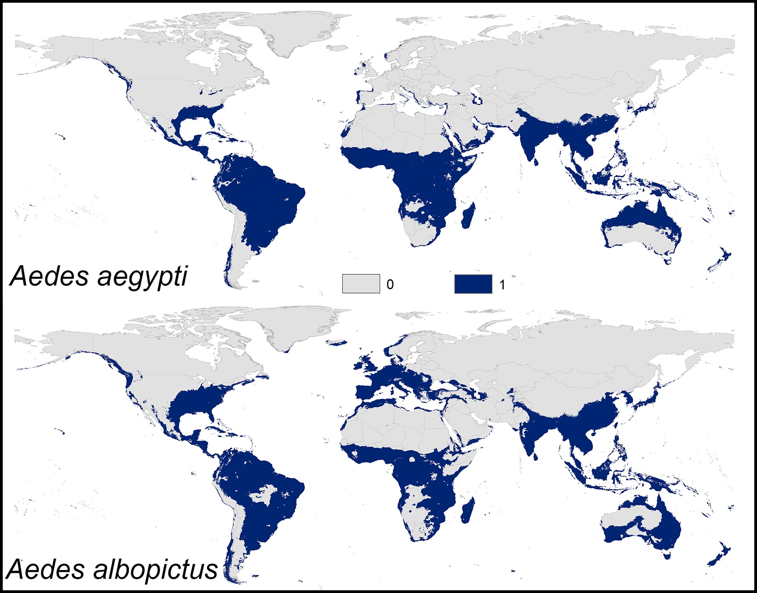
Asian Tiger Mosquito (Aedes albopictus)
One of most invasive insects in the world
Spread from SE Asia to every continent in 30 years
Transmits viruses (dengue, Zika, Chikungunya)
Introduced to U.S. in 1985

Slide 4
Introduction to California (2001 – 2012)
First population detected in 2001 (LA01)
From imported lucky bamboo (China)
Aggressive control efforts
Thought to be eradicated
Another population detected in 2011 (LA11)
What is the origin of the 2011 population?
Notes:
Images:
https://www.cdc.gov/mosquitoes/mosquito-control/professionals/range.html
https://journals.plos.org/plosone/article?id=10.1371/journal.pone.0210122

Slide 5
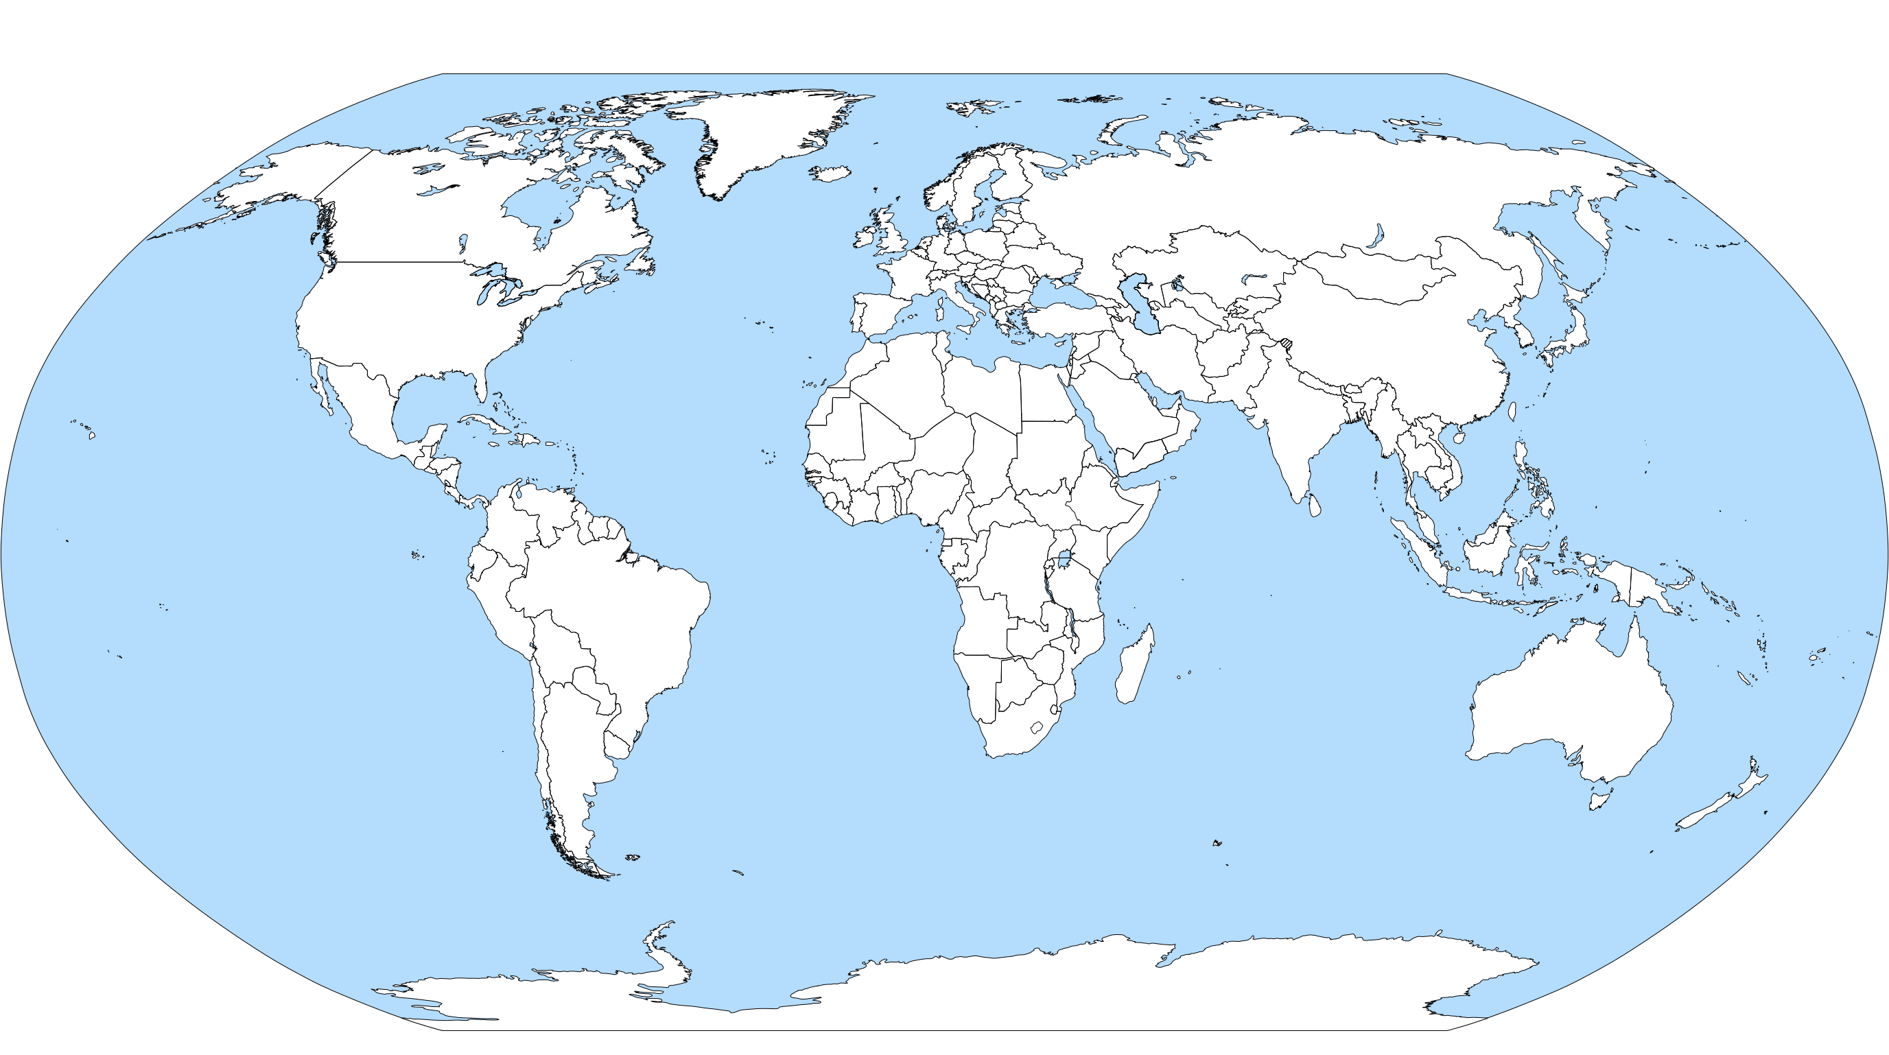
Their approach
346 mosquitoes from 12 locations around the world
Sequenced mitochondrial C01 gene
Analyze relationships between samples
Try to determine origin of LA11 population

Slide 6
Their Workflow
DNA Extraction
Sequencing
Alignment (BioEdit)
Diversity Analysis (DnaSP)
Visualization (Missing)
Clean Up (Missing)
Notes:
How were these sequences looked at? Were some sequencing results not clear and not used?
What programs were used to make the graphs so then others can follow up on it?

Slide 7
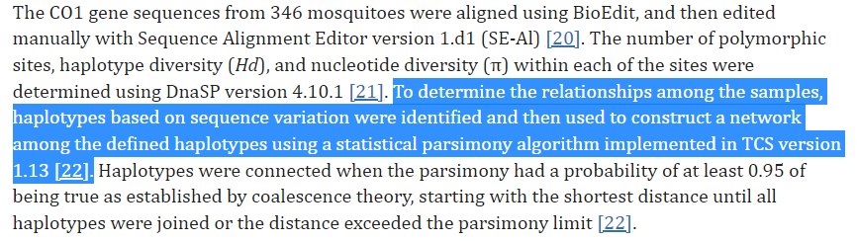
Their approach

Slide 8
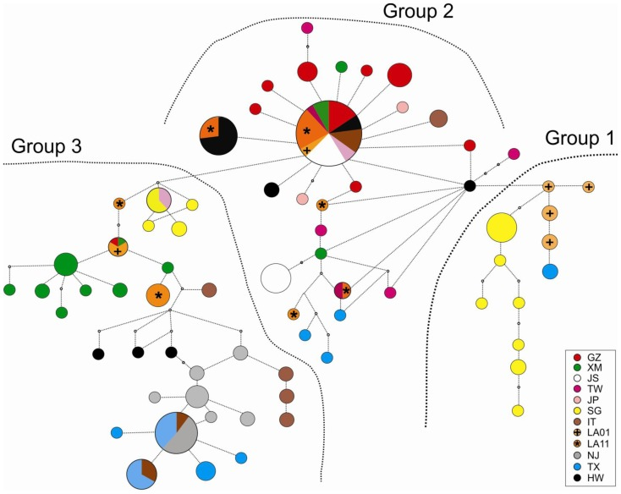
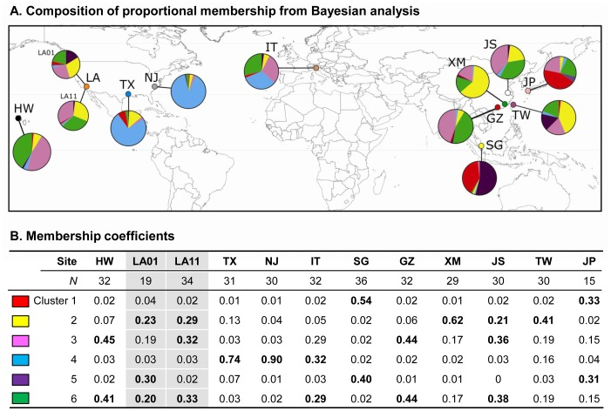
Results of this study
New Jersey (NJ), Texas (TX), populations closely related
Los Angeles (LA01, LA11) closely related to Singapore (SG) and southern China (GZ, XM, JS)
New Jersey (NJ), Texas (TX) clustered together (cluster 4)
southern China (GZ, XM, JS) and Taiwan (TW) shared with Los Angeles (LA01, LA11)
Suggests temperate Asian origin for LA samples
Notes:
Group 1 consists of: Singapore, and LA01
Group 2 consists of: Guangzhou China, Taiwan, Japan, and Hawaii
Group 3 consists of: Xiamen, China, LAs01 and LA11 which are futher connected to haplotypes from Europe and eastern central U.S.
66 haplotypes

Slide 9
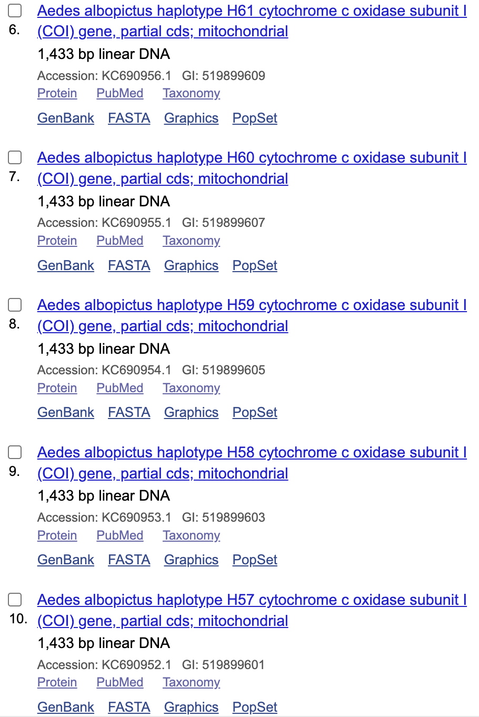
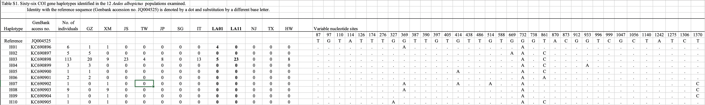
Their Documentation
1 Paragraph in methods section
Software versions and some parameters used
66 representative sequences deposited into GenBank
Supplementary table of CO1 haplotypes and locations
No GitHub repository or code, limited raw data provided
Notes:
Taq polymerase

Slide 10
Our workflow and documentation
Downloading the 66 Haplotypes (FASTA)
Uploading sequence onto DnaSP (Output: NEXUS)
Adding location data to NEXUS file
Loading Data onto PopART (Population Analysis with Reticulate Trees)
Perform a TCS Network
All work documented on GitHub
Data files for each step in the workflow
Code used to produce the files (when possible)
Markdown files with links to software used and description of analysis performed
Notes:
How were these sequences looked at? Were some sequencing results not clear and not used?
What programs were used to make the graphs so then others can follow up on it?

Slide 11
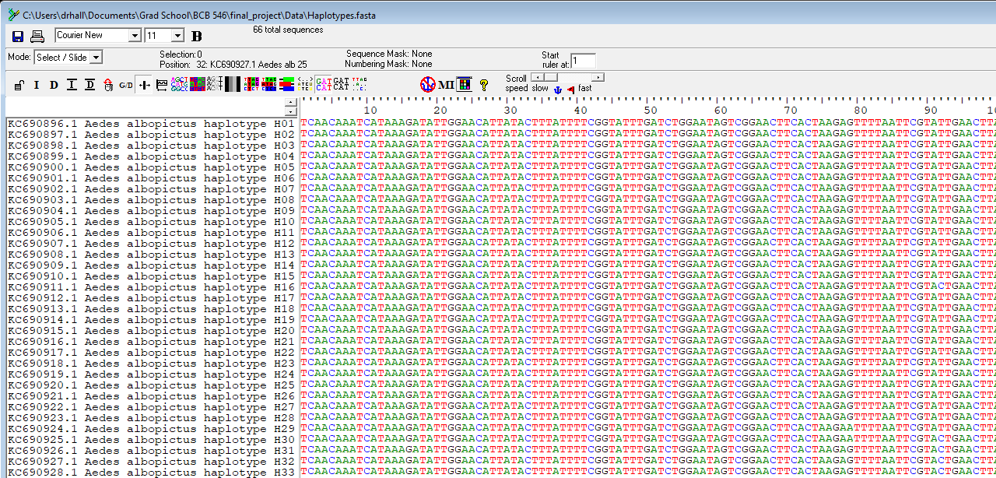
Downloading the 66 Haplotypes (FASTA)
Uploading sequence onto DnaSP (Output: NEXUS)
Adding location data to NEXUS file
Loading Data onto PopART (Population Analysis with Reticulate Trees)
Perform a TCS Network
66 representative haplotype sequences from GB (FASTA)
Verified alignment in BioEdit (Authors' methods)
Also verified in python using Bio.AlignIO (Biopython)

Slide 12
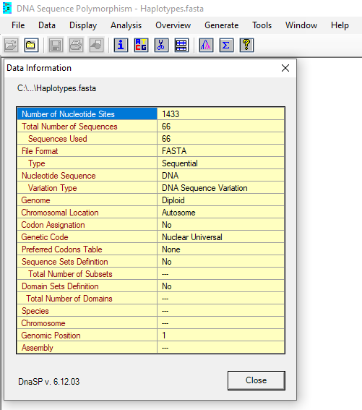
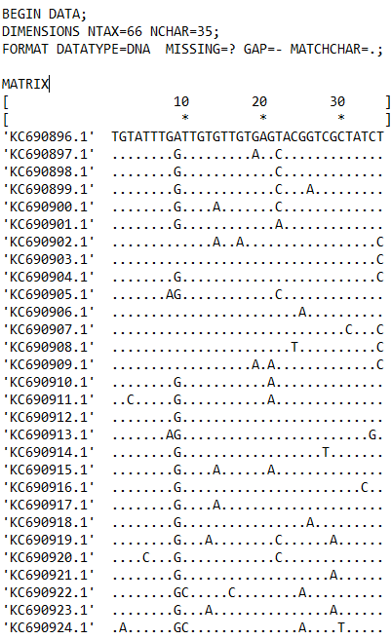
Downloading the 66 Haplotypes (FASTA)
Uploading sequence onto DnaSP (Output: NEXUS)
Adding location data to NEXUS file
Loading Data onto PopART (Population Analysis with Reticulate Trees)
Perform a TCS Network
Loaded alignment into DnaSP (DNA sequence polymorphism)
Generated sequence polymorphism file (Nexus format)

Slide 13
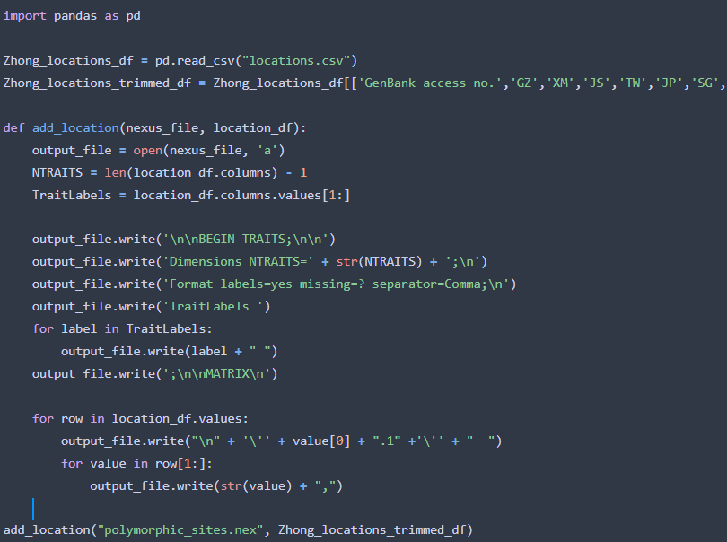
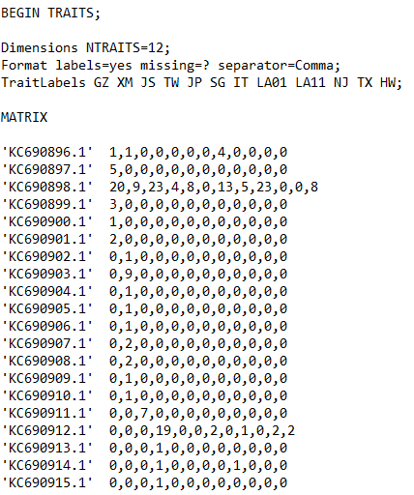
Downloading the 66 Haplotypes (FASTA)
Uploading sequence onto DnaSP (Output: NEXUS)
Adding location data to NEXUS file
Loading Data onto PopART (Population Analysis with Reticulate Trees)
Perform a TCS Network
Location data provided in CSV file (supplement)
Python script to extract and add location data in Nexus format

Slide 14
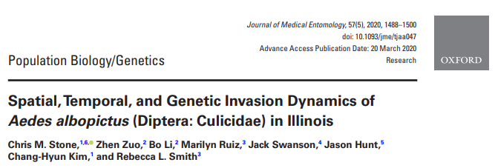
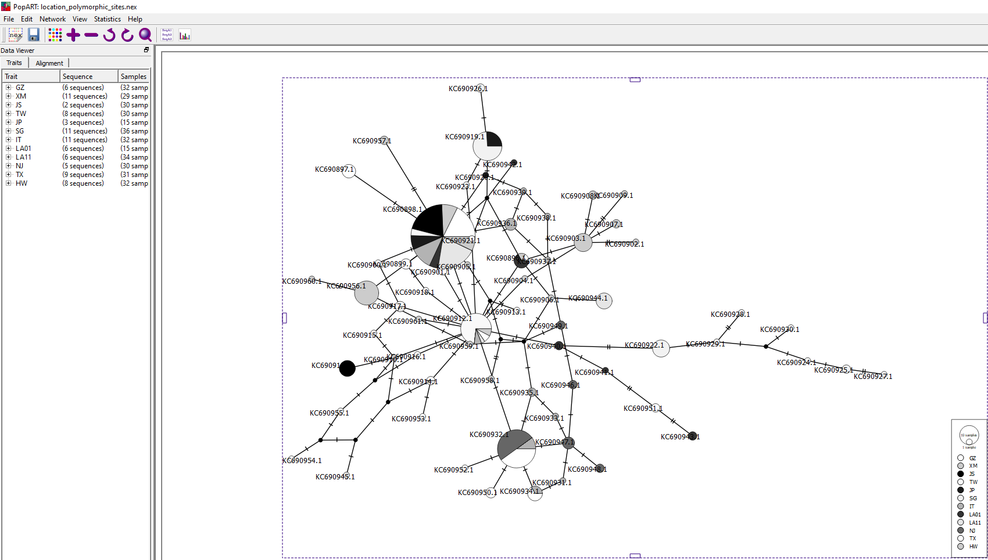
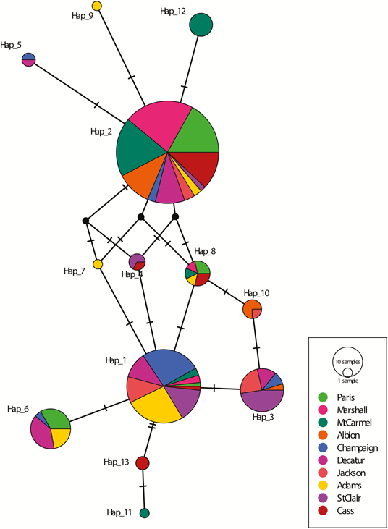
Downloading the 66 Haplotypes (FASTA)
Uploading sequence onto DnaSP (Output: NEXUS)
Adding location data to NEXUS file
Loading Data onto PopART (Population Analysis with Reticulate Trees)
Perform a TCS Network
Original software (TCS) no longer available
Found another paper with similar analysis
Loaded data into PopART and generated TCS tree
Notes:
TCS --> Transitive Consistency Score

Slide 15
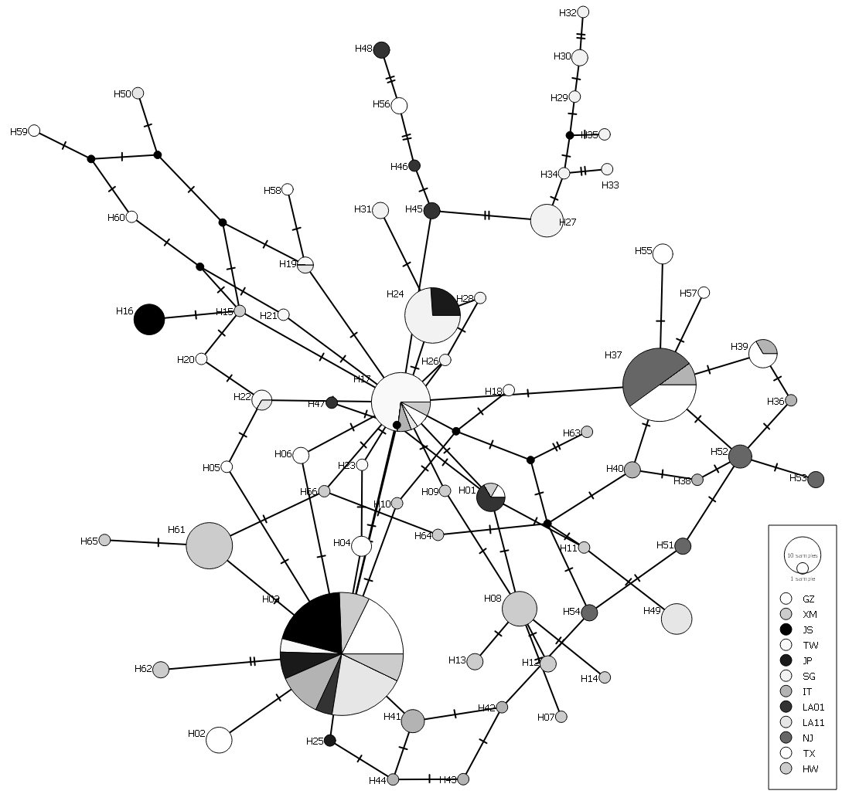
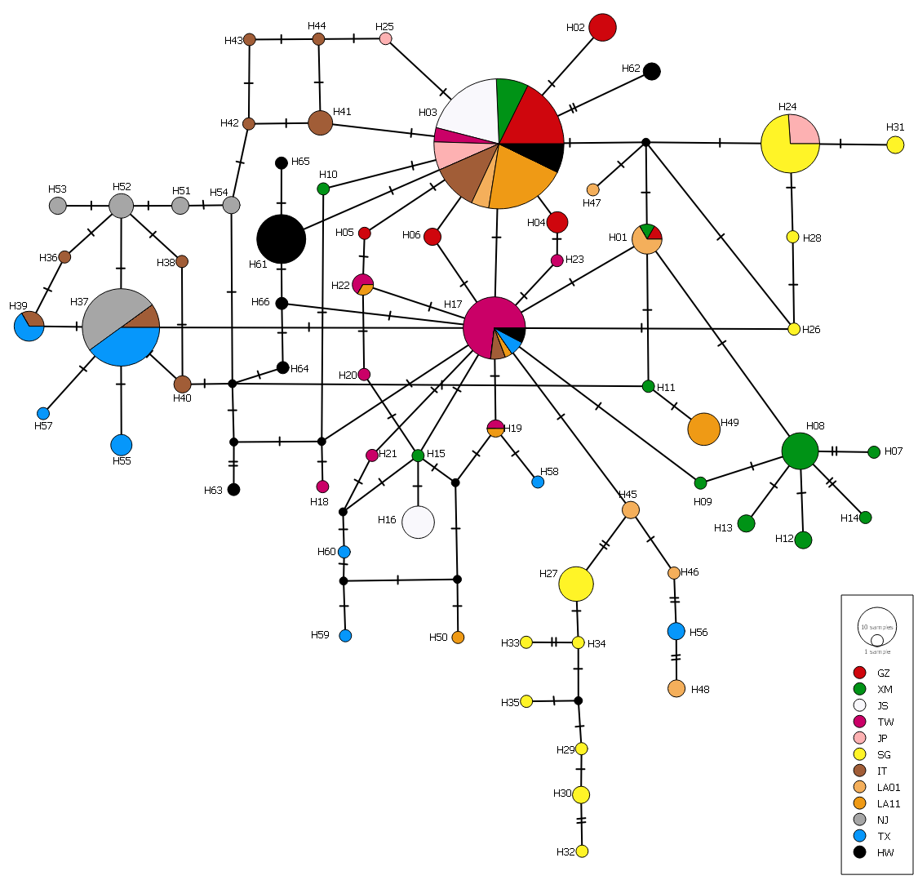
Untangling the network

Slide 16
Comparison to original
Some similarities, but significant differences

Slide 17
Takeaways
Results generally similar, but not the same
Wouldn't change conclusions, mostly qualitative
Some differences might be down to different software or our mistakes
Other differences we can't justify
Would it change the rest of the analysis?

